Slide 1

HTML List & Table Tags and Their Attributes
A comprehensive guide to structuring web content effectively using HTML's powerful organizational elements. We'll explore the essential tags, attributes, and best practices for creating well-structured lists and tables in modern web development.

Slide 2




HTML List Tags Overview
<ul> - Unordered List
<ol> - Ordered List
Creates a bulleted list where the order of items doesn't imply importance or sequence. Perfect for navigation menus, feature lists, or any collection of items without hierarchy.
Generates a numbered or lettered list where sequence matters. Ideal for instructions, rankings, or any content where the order of items has significance.
<li> - List Item
The building block for both unordered and ordered lists. Each <li> represents a single item within the parent list. Can contain text, images, or even other lists.

Slide 3

List Attributes and Examples
Key Attributes
The value attribute for <li> sets the starting number for an ordered list item
and all subsequent items.
Lists can be nested by placing a new <ul> or <ol> inside an <li> element,
creating hierarchical structures.
Modern practice uses CSS to control bullet/number appearance
through the list-style-type property.
<ol>
<li>Item starting at 5</li>
<li>Automatically becomes 6</li>
<li> Nested list:
<ul>
<li>Bullet point</li>
</ul>
</li>
</ol>

Slide 4





HTML Table Tags Overview
<table>
The container element that defines a table. All table content must be placed within this tag.
<tr>
Table Row element defines a horizontal row of cells. Contains <th> or <td> elements.
<th>
Table Header cell for column/row headings. Bold and centered by default.
<td>
Table Data cell contains the actual content for each cell in the table.
Additional semantic elements include <caption> for table titles, <thead>, <tbody>, and <tfoot> for logical sections, and <colgroup>/<col> for column-based styling.

Slide 5
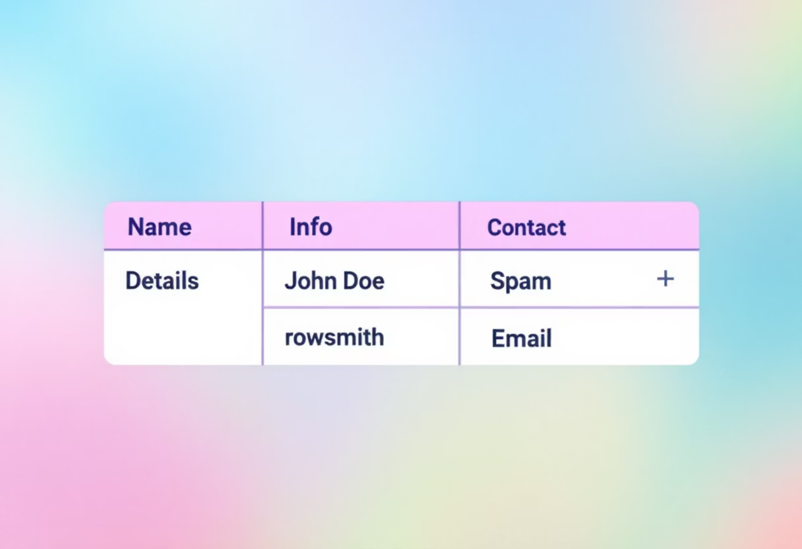
Table Attributes and Usage
Common Attributes
Many traditional table attributes are now deprecated in HTML5:
border: sets table border width
cellpadding: space inside cells
cellspacing: space between cells
align: horizontal alignment
bgcolor: background color
Modern practice strongly favors CSS for all styling aspects.
Cell Spanning
<td colspan="2">Merged two columns</td>
Control how cells span across rows or columns:
colspan: number of columns a cell spans
rowspan: number of rows a cell spans

